Slide 1

Co-curriculum Day

Slide 2

Introduction
Date: 6 March 2019 (Wednesday)
Time: 1.00p.m. to 4.00p.m.
Venue: SJK(C) Kampar Girls
Participants: 25 students (from standard 4 to standard 6 )
3 Activities:
“4 Colours Challenge”
“General Knowledge Session”
“Effective Communication Games”
Ngu Yi Hui

Slide 3

Group Dynamics
Running out of time
Only three hours
Cannot complete the activities during duration
Take time to control the students => delayed our schedule
Way to overcome
Make sure every members know the program flow
Compile all activities and account for time
Lim Chien Ai

Slide 4
2. Overspending
Use idea “plan and spend as you go” method => overspending
Total rewards prepared more than enough compare to number of students
Ways to overcome
Set a clear budget list
Do some research before purchase
Prepare rewards after confirm the number of students
Lim Chien Ai

Slide 5
3. Losing students' attention
10 to 12 year old
Easily get attracted by other disturbance
Need time to control them
Way to overcome
Create an excitement event => keeps students alert and interested
Try to do something is unexpected => reengage the students' brain
Wong Zhen Yang

Slide 6
4. Careless mistake during preparation
forgetting to think about seat arrangements => simply arrange for students
Ways to overcome
Create an in-depth event that describes what we need to do, and whom is responsible for task.
Make sure group members clear about the plan
Check the progress
Wong Zhen Yang

Slide 7
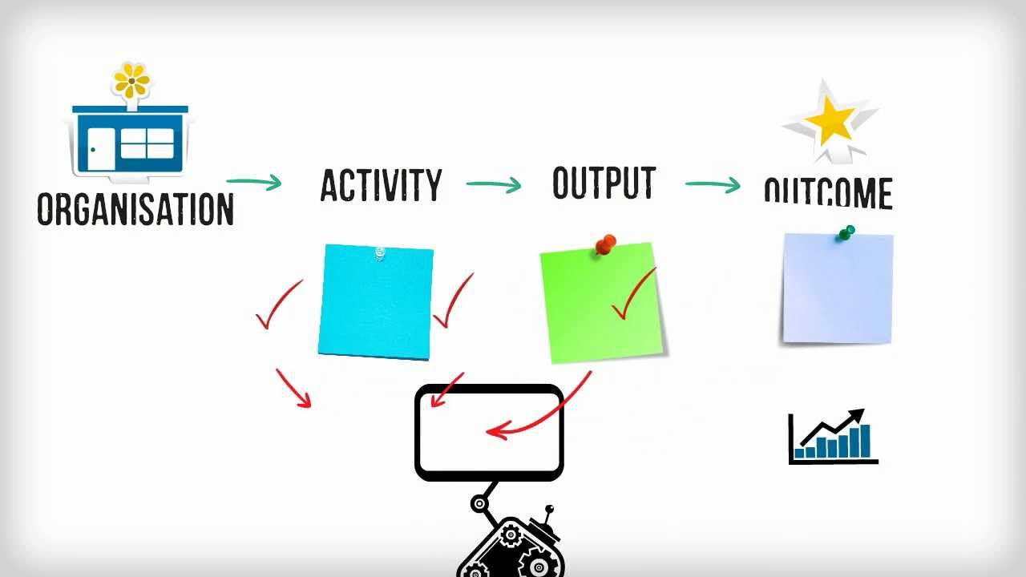
Social Impact of the Project
Lee Chun Hao

Slide 8
Social impact of the project
Critical thinking skill
Time manage-ment
Gain of general knowledge
Effective communi-cation skill
Leader-ship
Team-work
Lee Chun Hao

Slide 9
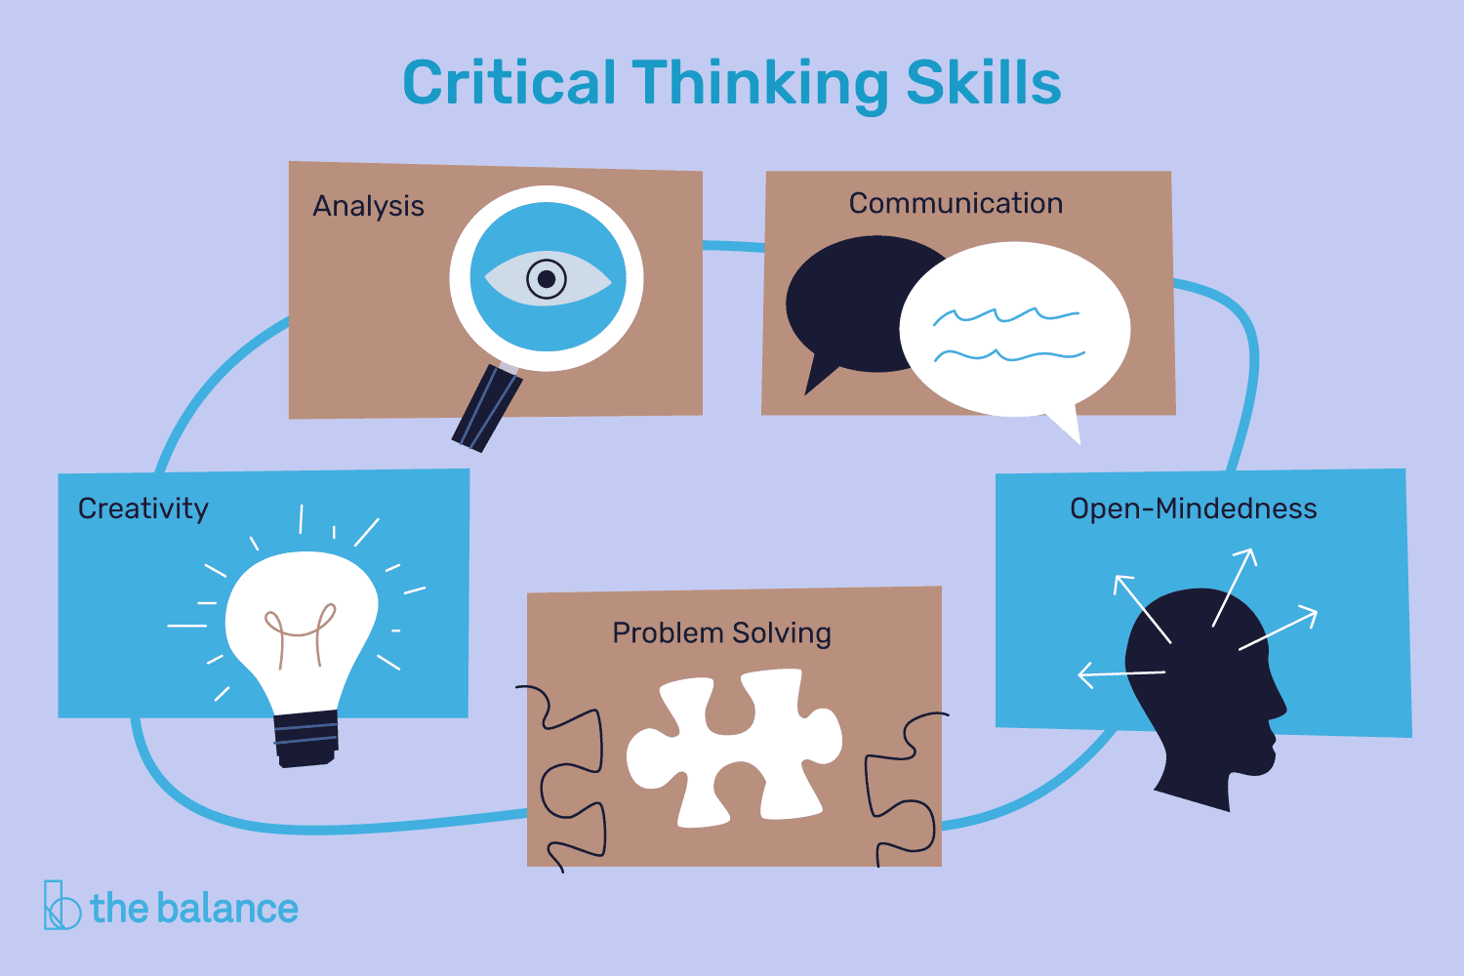
Social Impact : Critical Thinking Skill
Analysis of the problem
Thinking of the solution
Problem solving
Lee Chun Hao

Slide 10

Social Impact : Time management
Finish the task in a given time
Effective distribute their time to complete the task
Cannot overtime
Lee Chun Hao

Slide 11

Social Impact : Gain of general knowledge
Gain of general knowledge instead of Math and Science
Updated to current issue occur
Lee Chun Hao

Slide 12

Social Impact: Effective Communication Skill
Send the message precisely
Do not misleading others
Avoid conflict
Lee Chun Hao

Slide 13
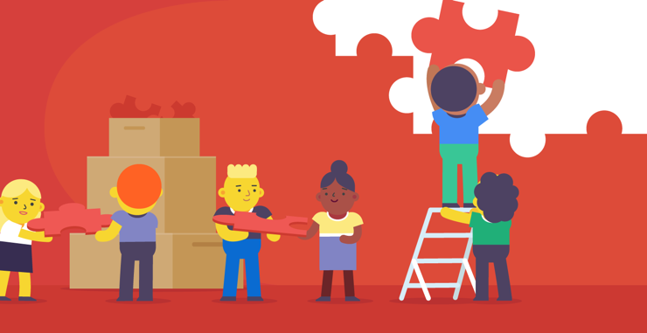
Social Impact : Teamwork
Forming of group
Collaborate together to complete the task
Lee Chun Hao

Slide 14
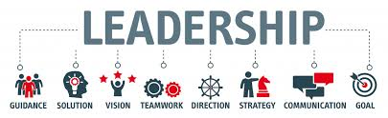
Social Impact : Leadership
Unite the member
Motivate them
Direct them to achieve the goals
Lee Chun Hao

Slide 15


Sustainability Impact of the Project
Lifelong learning
Sustainable for whole life
Wong Zhen Yang

Slide 16
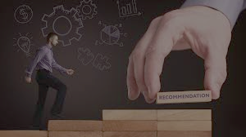
Recommendation
Time management
- detail timetable draft
- everyone in the group sketch their own schedule
Budget
- determine the exact number of participants
Ability in taking control of the crowd
- making them put more attention to us
- evaluate and rewards the students
Chai Ming Way

Slide 17
Conclusion
Things that we have learnt:
Think critically
Effective communication
Be more patient
Feedback from students:
Most were satisfied
Some felt boring – prefer outdoors activities
Ngu Yi Hui

Slide 18

The End

